Slide 1

Fairweather pedestrians of the Big Apple.
Is there a link between weather for Uber and non-Uber rides services usage in New York City?
Group 5: Pablo Crespo, Victoria Wise, Trushil Patel, Steve Moss

Slide 2

The Thinking Behind…
New York is one of the busiest city of United States of America, with its own population and tourists seeing the Big Apple, the need of ride services to get to A to B is highly demanded, but does the weather influence the ride services usage?
We were curious to find out:
Is there a link between weather for Uber and non-Uber rides services usage in New York City?
Research questions from our proposal:
What are some findings on the commuter habits?
Does weather impact on number of Uber Rides request?
Time of the day that has the most Uber Rides request?
Time of the week that has the most Uber Rides request?
GitHub was fully utilised by the team to share work.

Slide 3
Raw Data Source:
Uber and non-Uber vehicle rides in New York City
Dataset from Uber Pickups in New York City by FiveThirtyEight on Kaggle (https://www.kaggle.com/fivethirtyeight/uber-pickups-in-new-york-city)
Uber rides: 4 files of raw data on pickups from Uber, separated by month, with detailed location information.
Non-Uber vehicle rides: 8 files of raw data on pickups from non-Uber for-hire vehicle (FHV) companies. The trip information varies by company, but can include day of trip, time of trip, pickup location, driver's for-hire license number, and vehicle's for-hire license number.
Historical Weather API
Dataset from Weather API and Data for Businesses and Developers (https://www.worldweatheronline.com/developer/)
Time frame requested from the Historical Weather API is between 1st July 2014 – 30th Sep 2014
We have kept below data from the Historical Weather API for our project:
Date
Average, Max, and Min temperature in Celsius
UV index
Precipitation by millimeters
Weather description
Cloud cover by percentage
Humidity by percentage

Slide 4
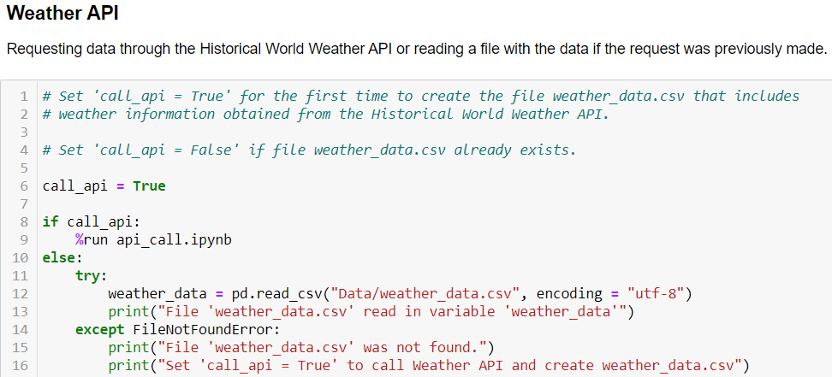
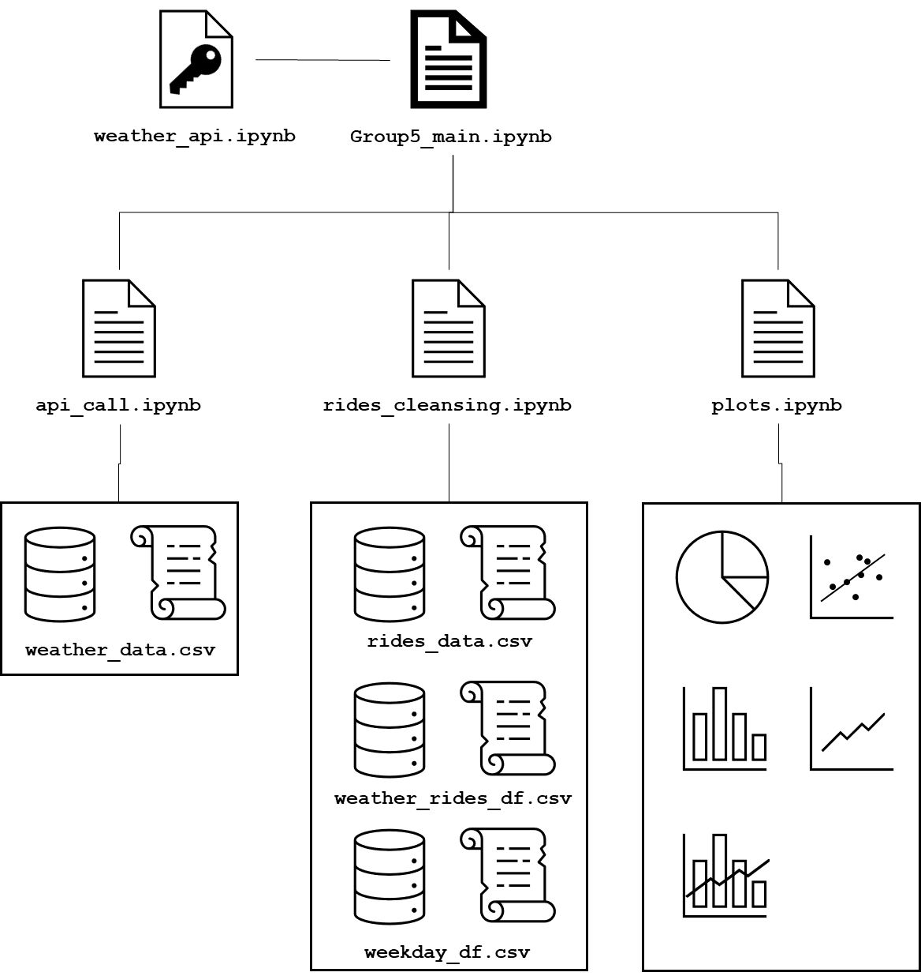
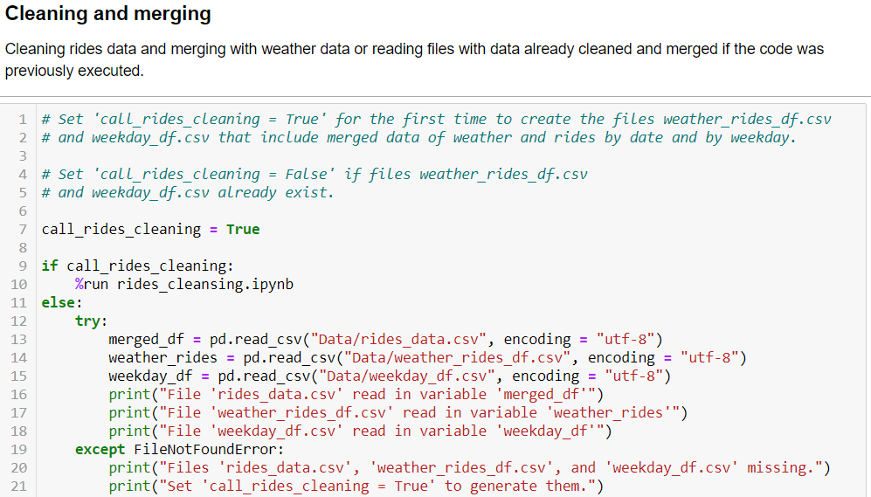
1
Control File
2
3

Slide 5
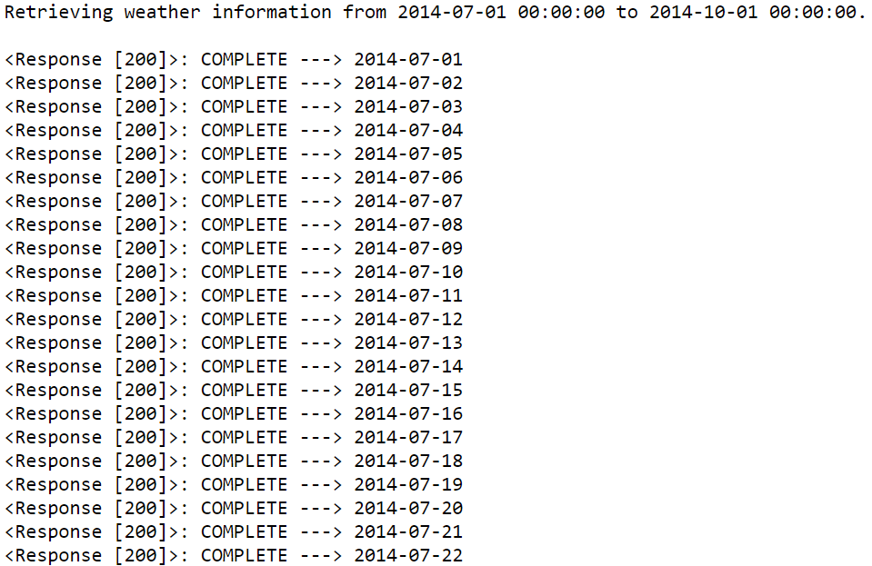
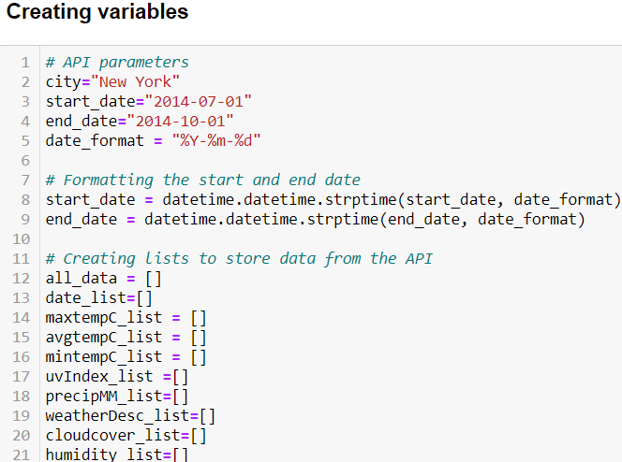
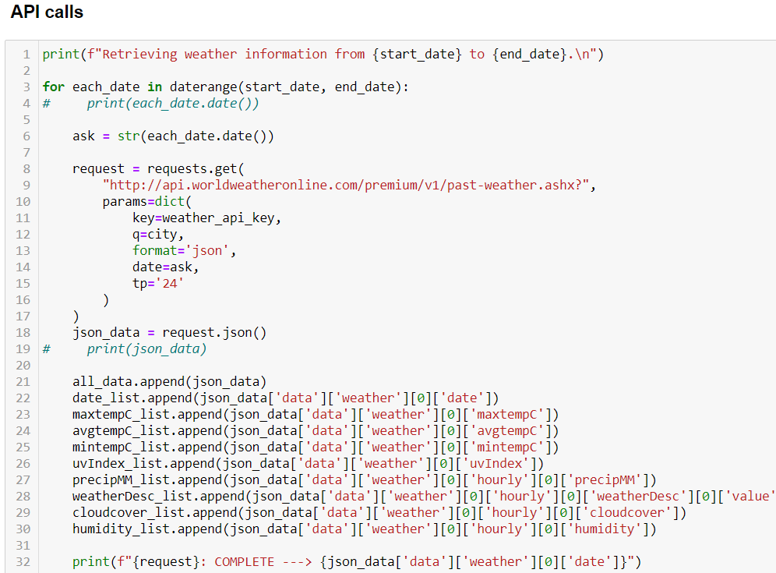
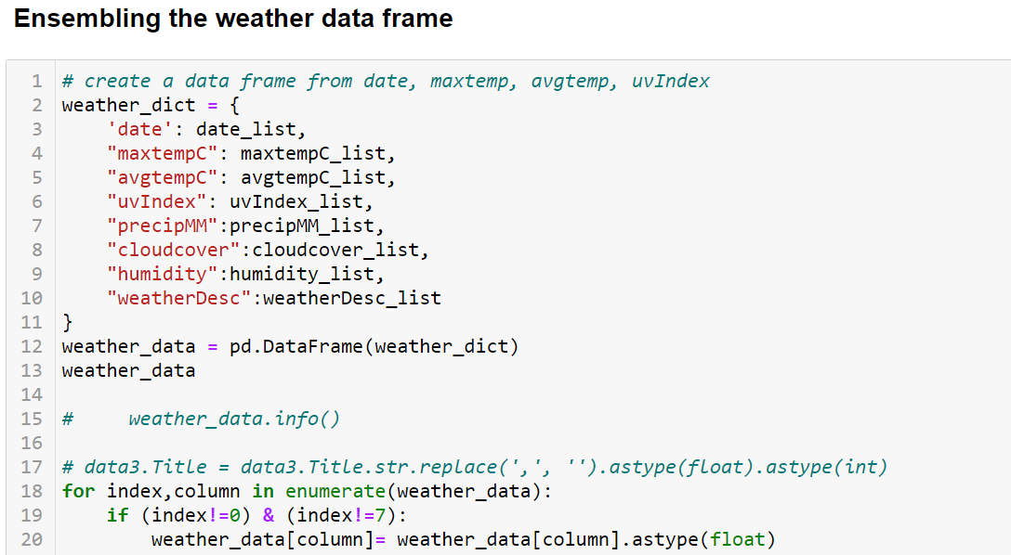
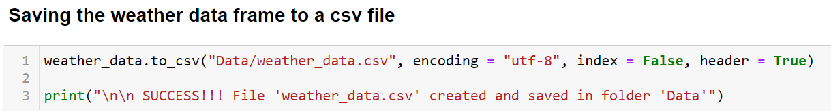
API calls
1
2
3
4

Slide 6
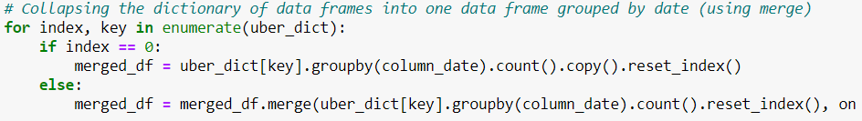
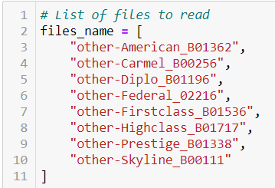
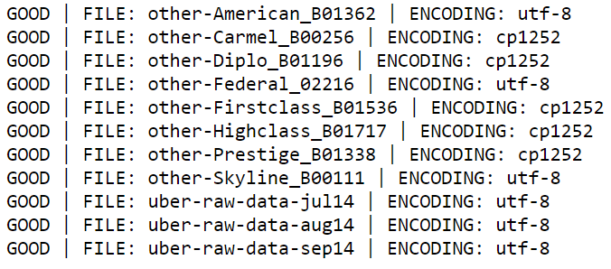
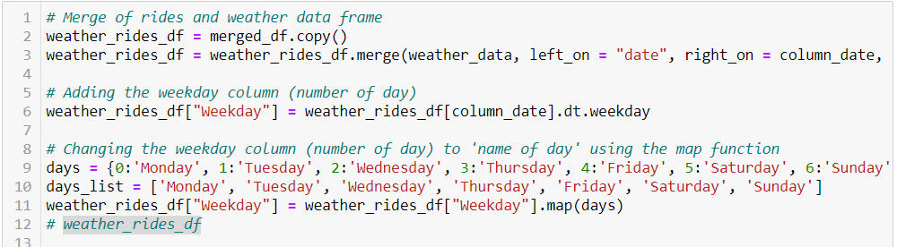
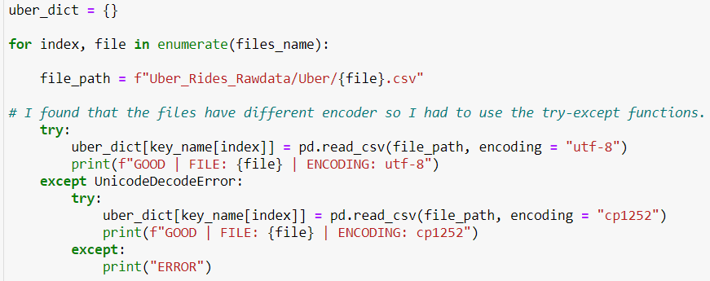
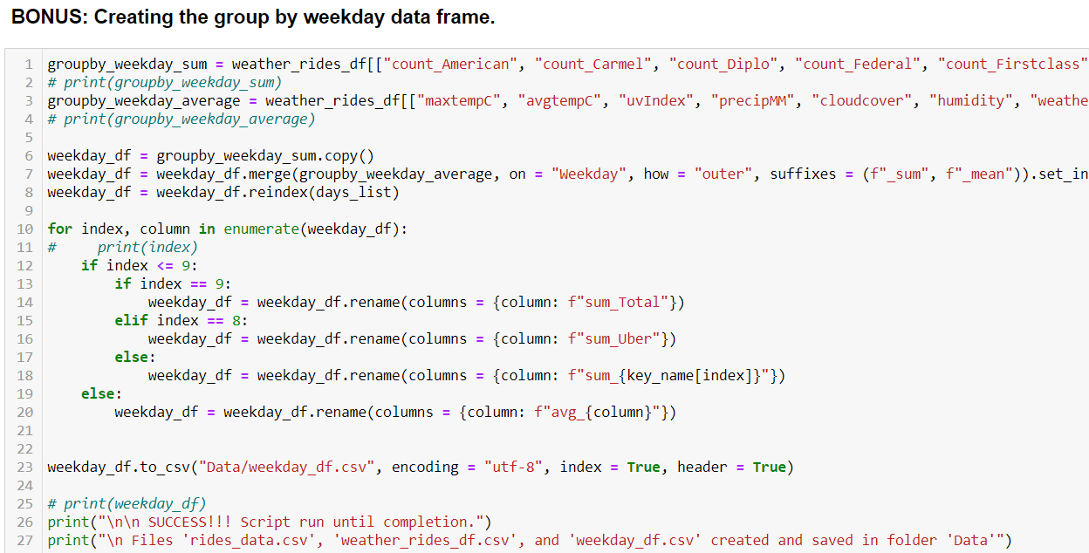
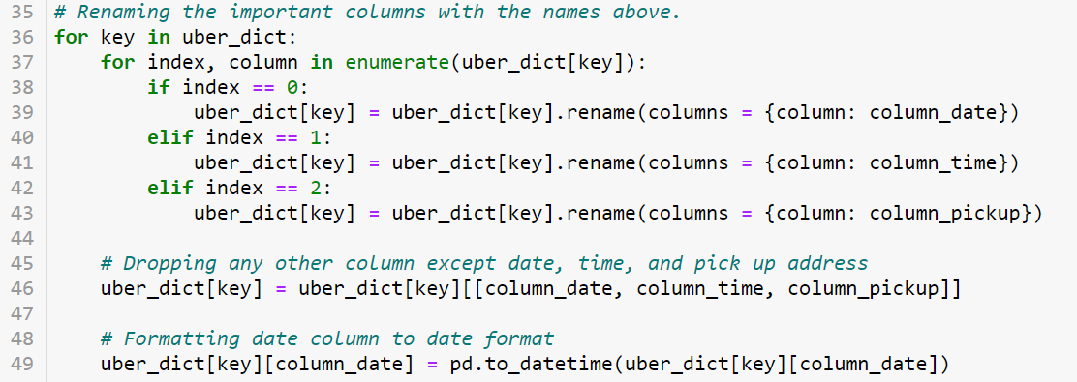
4
Rides cleansing and weather merging
1
5
2
6
3

Slide 7
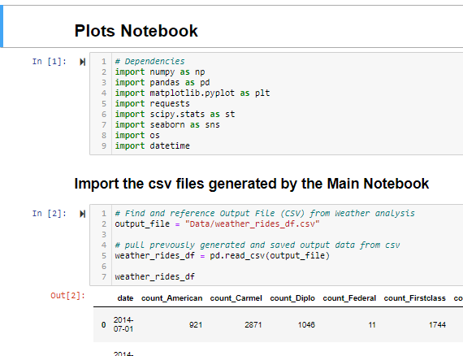
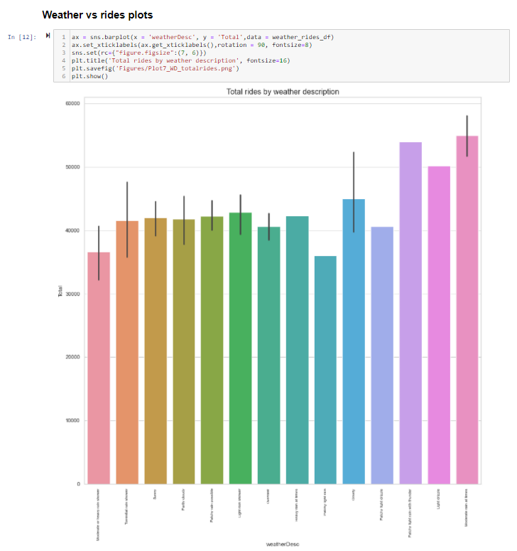
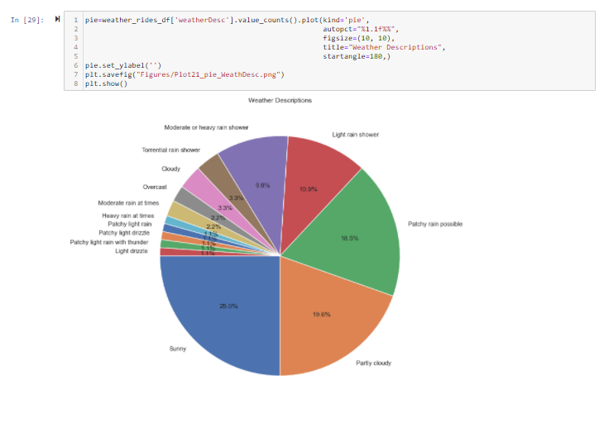
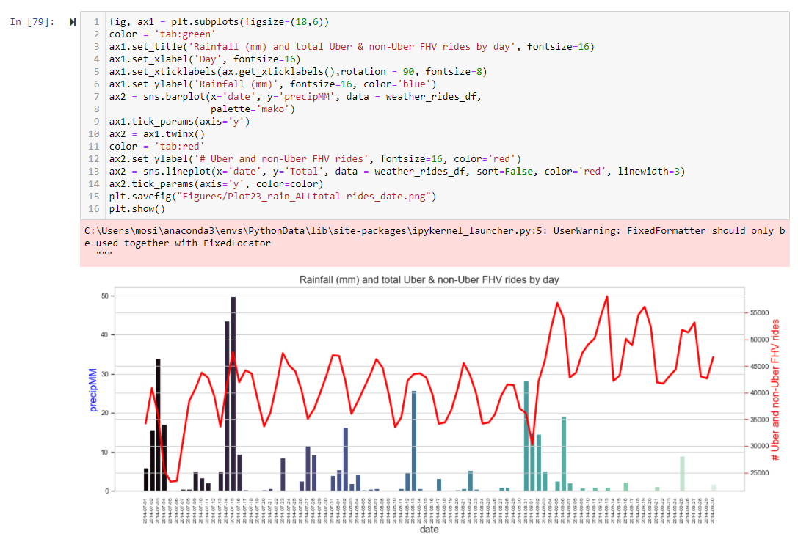
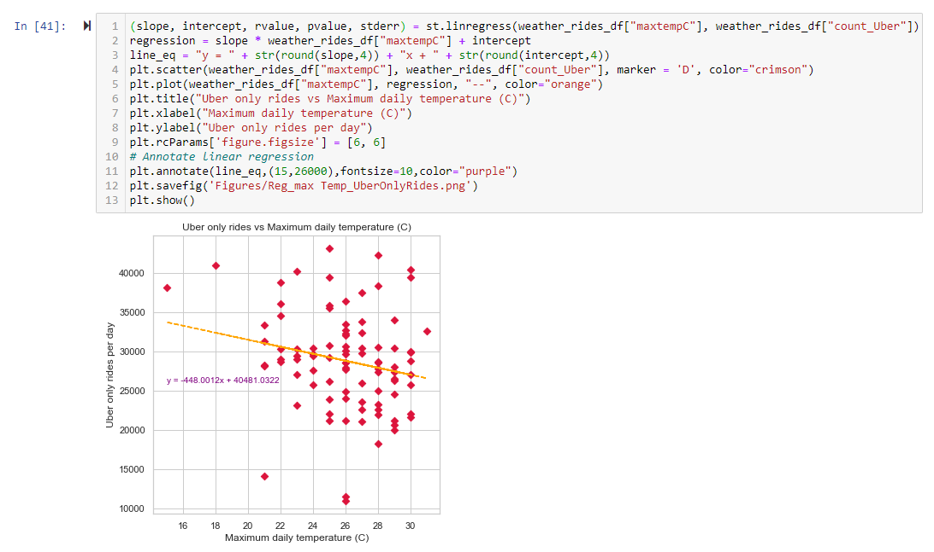
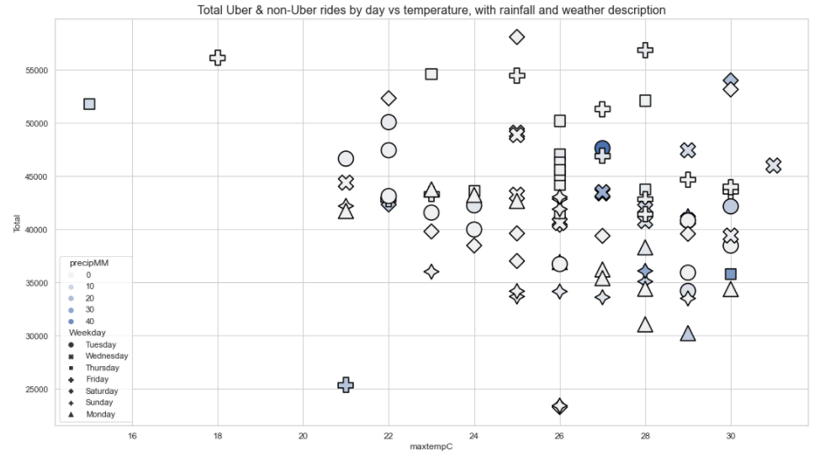
Analysis Process
Created separate Jupyter Notebook for all plotting, basic statistical analysis (mean, max, min), generate correlation coefficients and undertake regression analysis
Plots included scatter, pie, bar, combination bar and line
Used Matlibplot and Seaborn visualization libraries
Key stats established from the analysis process:
Max, min, median of
Daily max temp
Daily Rainfall
Daily humidity
Daily cloud cover
Daily UV Index
Number of non-Uber FHV rides in time period
Number of Uber rides in time period

Slide 8
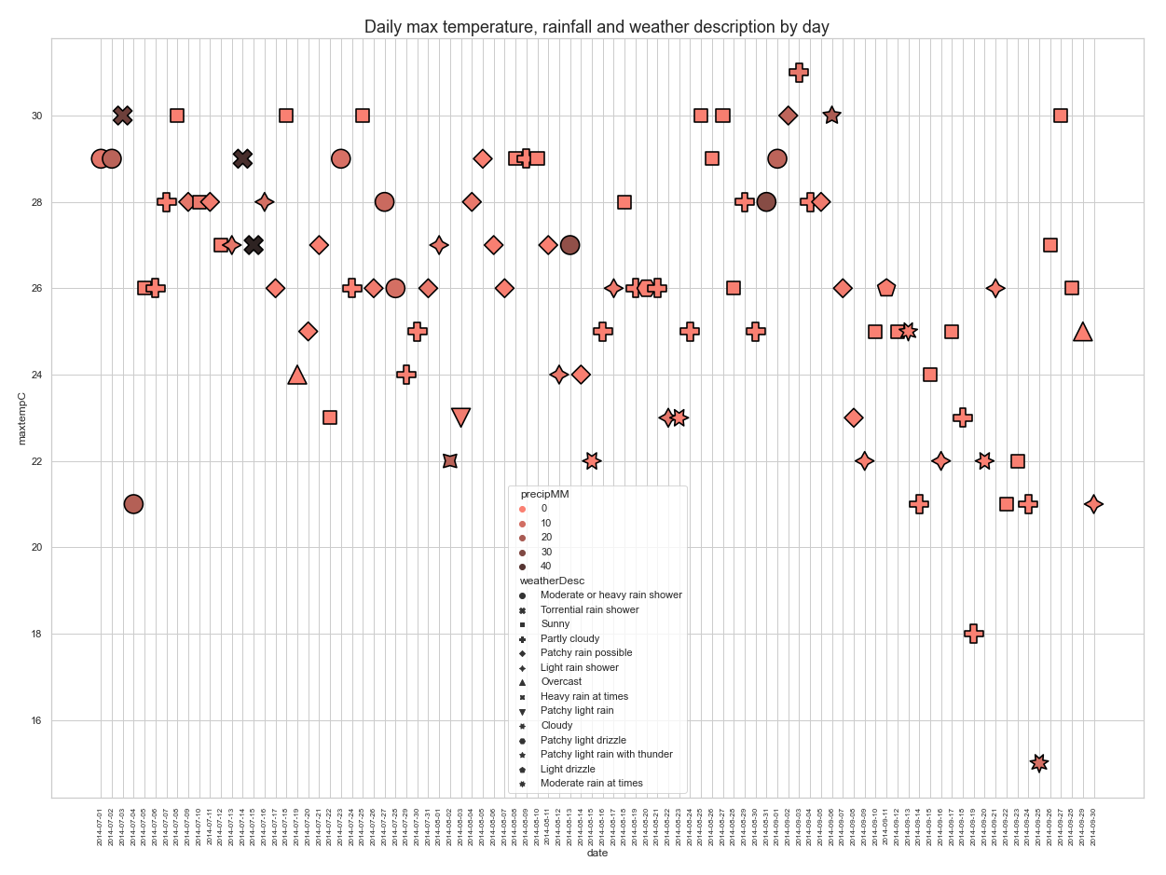
Details of the weather in New York between 1 July and 30 September 2014
Plot of the weather data for New York between 1 July 2014 and 30 September 2014
Max temperature is shown on the y-axis, individual days on the x-axis
The symbols are colour coded by maximum rainfall in mm (precipMM) and the symbolised using the weather description for that day
Max daily temperatures drop off decrease in September
The mean daily max temperature is 26.0
The median daily max temperature is 26.0
The highest daily max temperature is 31.0
The lowest daily max temperature is 15.0
July
August
September

Slide 9
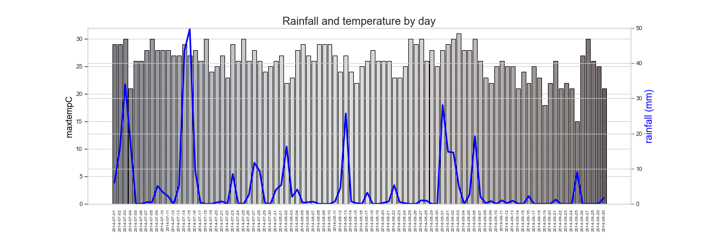
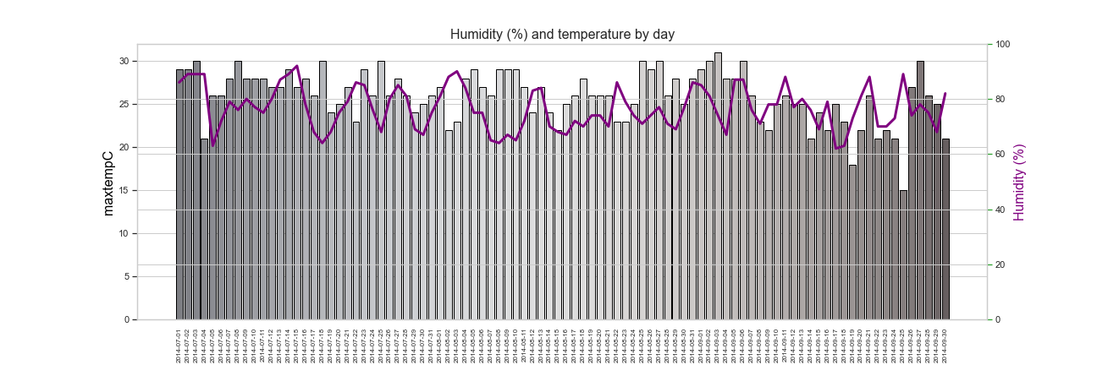
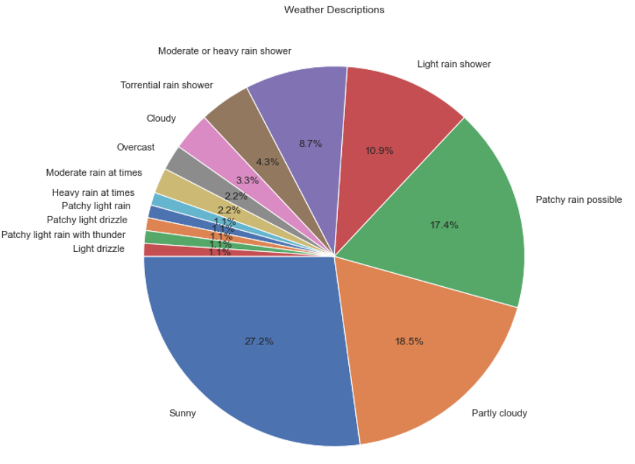
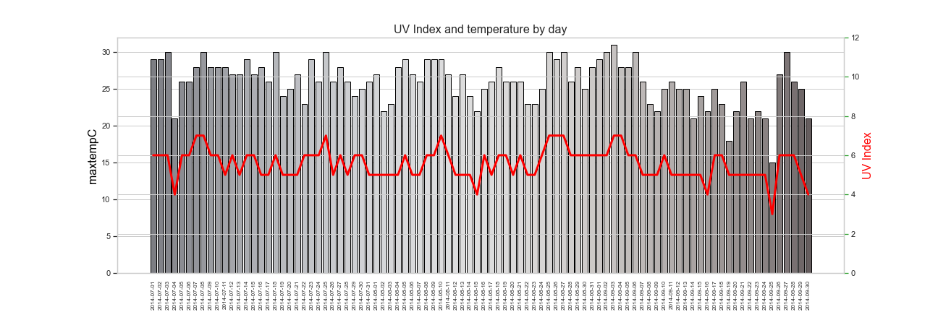
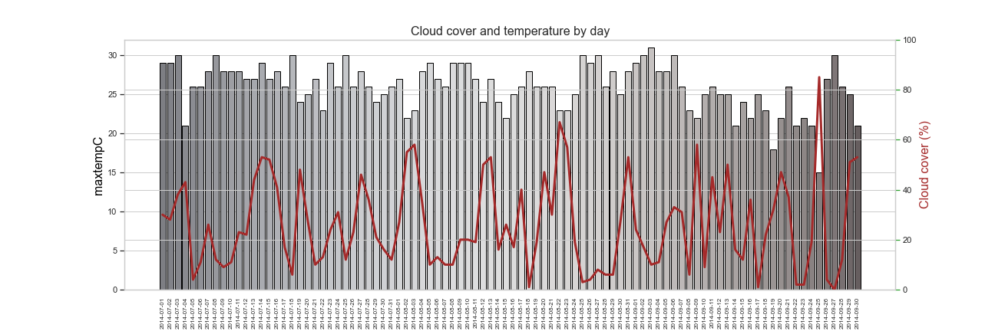
Details of the weather in New York between 1 July and 30 September 2014
Key findings indicates that the the humidity percentage varied between 62% - 92% during this period, and max temp between 15 to 31C (avg. 25.97C). We have learned that based on below dates and stats that the percentage of the humidity doesn't influence on the temperature:
Highest humidity days:
2014/07/14 humidity 92% & 27C
2014/08/03 humidity 90% & 23C
2014/07/03 humidity 89% & 30C
2014/07/04 humidity 89% & 21C
2014/08/03 humidity 89% & 15C
Key findings below indicating that the rainfall doesn't have an impact affecting the max temp of the day:
2014/07/15 50mm & 27C
2014/07/03 24mm & 30C
2014/08/31 29mm & 28C
2014/08/15 26mm & 22C
2014/09/06 19mm & 20C
Plot of max temperature vs rainfall:
The mean daily rain is 4.425
The median daily rain is 0.5
The highest daily rain is 49.7
The lowest daily rain is 0.0
Plot of max temperature vs humidity (%):
The mean daily humidity is 76.6
The median daily humidity is 76.0
The highest daily humidity is 92.0
The lowest daily humidity is 62.0
Combined 51.2% of days had no rain
Plot of max temperature vs UV index:
The mean daily uvIndex is 5.56
The median daily uvIndex is 6.0
The highest daily uvIndex is 7.0
The lowest daily uvIndex is 3.0
Plot of max temperature vs cloud over (%):
The mean daily cloud cover is 26.0
The median daily cloud cover is 22.5
The highest daily cloud cover is 85.0
The lowest daily cloud cover is 0.0
Finding shows that the UV index has been consistent between 3 - 7 during this period, and max temp between 15 to 31C (avg. 25.97C). We have learned that based on below dates and stats on days with lower UV index had the lowest max temp during this period:
2014/09/25 UV index 3 & 15C
2014/07/04 UV index 4 & 21C
2014/08/15 UV index 4 & 22C
2014/09/16 UV index 4 & 22C
Finding shows the cloud cover percentage varied between 0% - 85% during this period, and max temp between 15 to 31C (avg. 25.97C). We have learned that based on below dates and stats that the percentage of the cloud cover reflects on the temperature:
Highest cloud cover days:
2014/09/25 cloud cover 85% & 15C
2014/08/22 cloud cover 67% & 23C
Lowest cloud cover days:
2014/09/27 cloud cover 0% & 30C
2014/08/18 cloud cover 1% & 28C
Larger versions of figures in Appendix
Notes:
This slide is to discuss the weather in new York over the period of interest

Slide 10
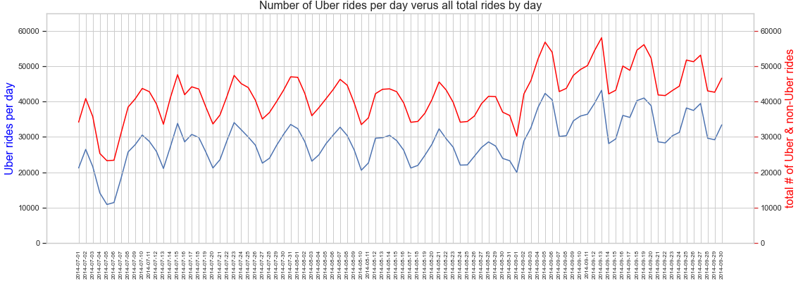
Details of the Uber and total rides (Uber and non-Uber FHV) in New York between 1 July and 30 September 2014
The mean daily # of Uber rides 28,842.73
The mean daily # of all rides 42,039.34
The highest daily number of Uber rides is 43,205
The lowest daily number of Uber rides is 10,890
What happens in early September 2014?
See weekday (5 day) – weekend (2 day) cyclicity in both the Uber rides and the total Uber and non-Uber FHV data

Slide 11
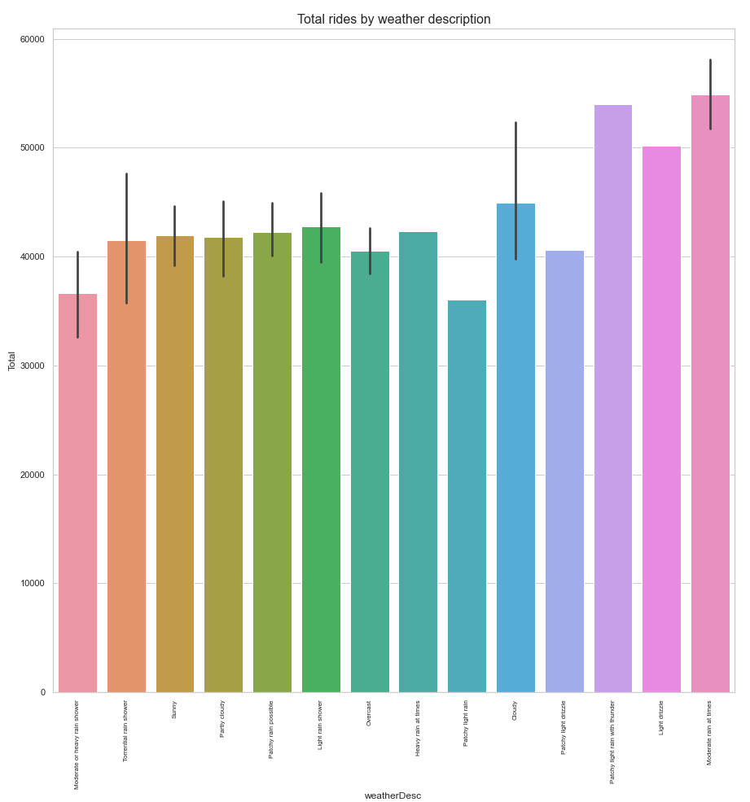
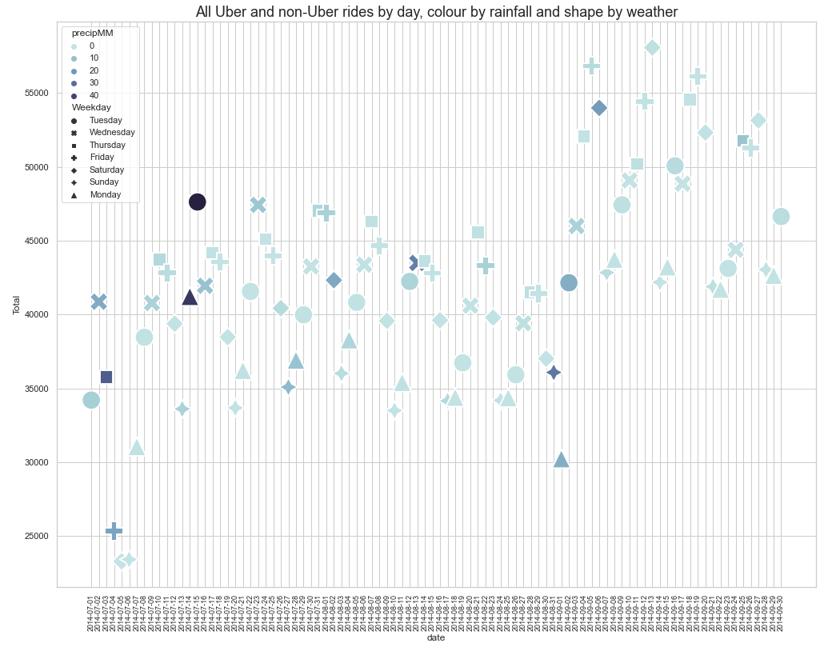
Details of the Uber and total rides in New York between 1 July and 30 September 2014 versus the weather
Torrential rain shower
Light rain shower
Patchy light rain
Patchy light drizzle
Sunny
Patchy light rain with thunder
Moderate rain at times
Partly cloudy
Patchy rain
Overcaet
Moderate or heavy rain shower
Heavy rain
Cloudy
Light drizzle
July
August
September
Chart of total rides by weather description
Plot of total rides by Uber & non-Uber FHV services - The symbols are colour coded by rainfall (mm) and the symbolised using the day of the week
Chart of total rides by weather description
Below are the orders of total rides by weather description:
1. Moderate rain at times
2. Patchy light rain with thunder
3. Light drizzle
4. Cloudy
5. Light rain shower
6. Heavy rain at times
7. Patchy rain possible
8. Sunny
9. Partly cloudy
10. Torrential rain shower
11. Overcast
12. Partly light drizzle
13. Moderate or heavy rain shower

Slide 12
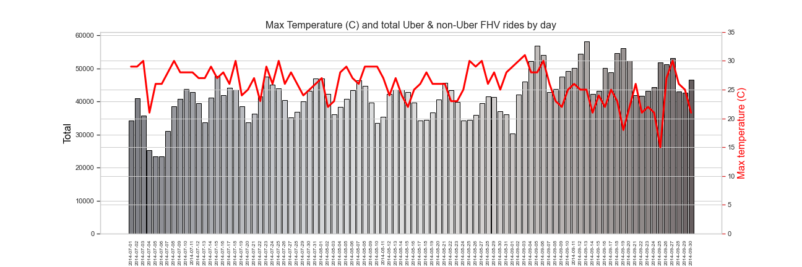
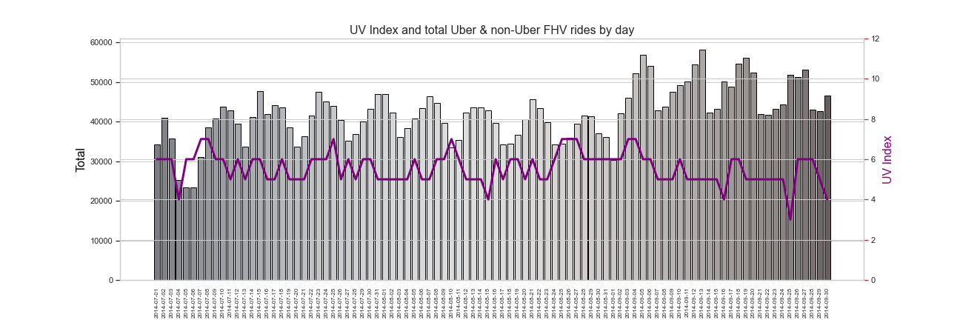
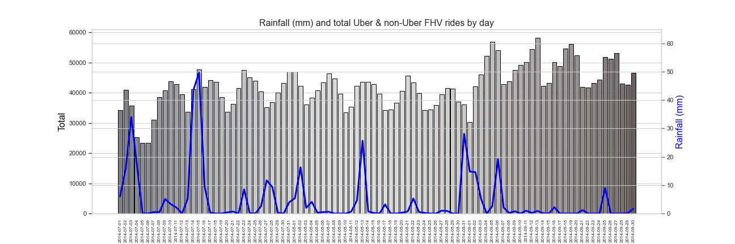
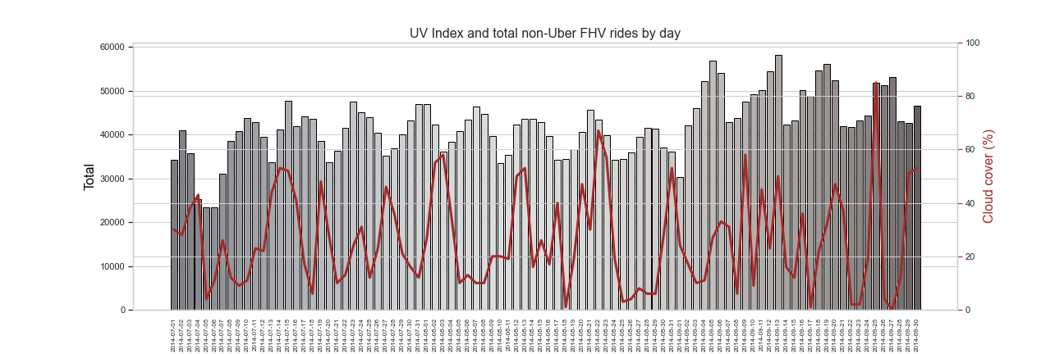
Details of the Uber and non-Uber FHV rides per day and weather in New York between 1 July and 30 September 2014
These are plots of the total Uber and non-Uber rides per day against, max daily temperature, rainfall (mm), UV Index and cloud cover
Plot of max temp vs total rides by day indicates no relationship showing the temperature despite hotter or colder affecting commuter habits in using rides service.
Plot of UV index vs total rides by day indicates no relationship showing UV index affecting commuter habits in using rides service.
Again can see weekday (5 day) – weekend (2 day) cyclicity in the total Uber and non-Uber FHV data
Plot of rainfall (mm) vs total rides by day indicates no relationship showing rainfall affecting commuter habits in using rides service, the peak rainfall days didn’t result higher riding rates and the highest days of total rides (Sep 2014) in fact had towards lowest rainfalls of the period.
Plot of cloud cover (%) vs total rides by day indicates no relationship showing cloud cover affecting commuter habits in using rides service.

Slide 13
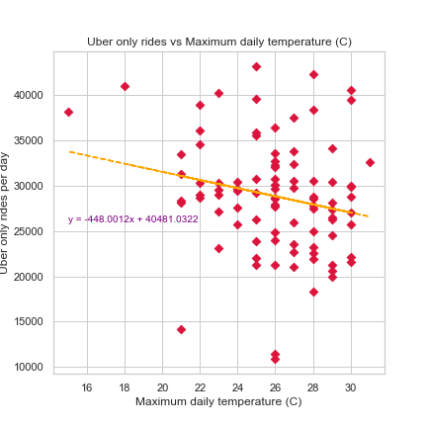
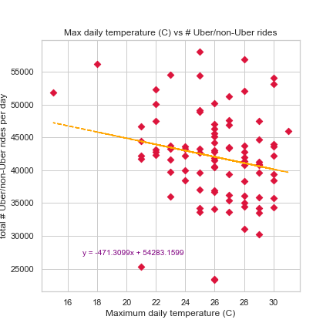
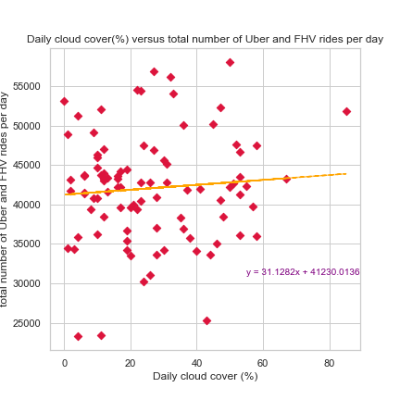
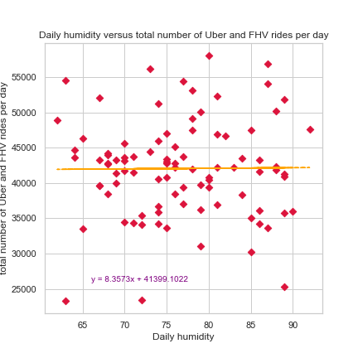
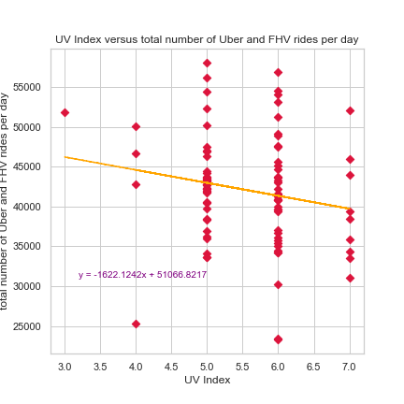
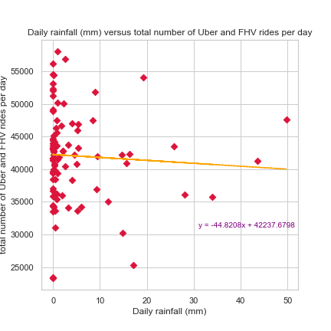
Statistical Analysis
Calculated correlation coefficient
Scatter plots with regression line
Conclusion from analysis
There is no correlation between number of daily rides and the weather for the time period investigated
Uber only rides vs max Temp
All rides vs max Temp
All rides vs cloud cover
The r correlation coefficient of max temp and total Uber only rides is r=-0.210
The r correlation coefficient of max temp and total rides is r=-0.204
The r correlation coefficient of cloud cover and total rides is r=0.082
All rides vs humidity
All rides vs UV Index
All rides vs rainfall
The r correlation coefficient of humidity and total rides is r=0.009
The r correlation coefficient of UV Index and total rides is r=-0.182
The r correlation coefficient of rainfall and total rides is r=-0.059

Slide 14
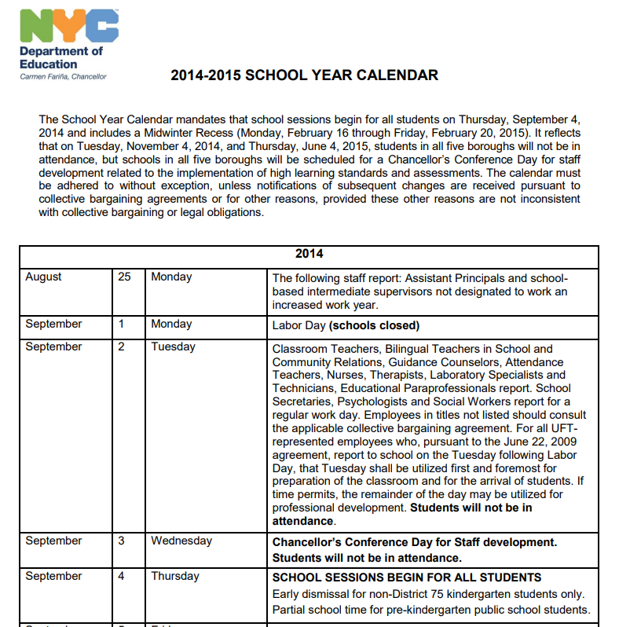
Why the increase in Total Uber & non-Uber FHV rides per day in early September 2014
Sorry Alice School’s out…… no more
Maybe not the weather but school’s back
American summer school includes July and August, school starts in September
https://www.nctq.org/dmsView/NYC_14-15_Calendar

Slide 15
Conclusions
Key Findings:
No correlation between Uber & non-UberFHV rides service usage and weather in the time period of the dataset
Based on evaluating below measurements against the daily total of rides service usage, we were unable to see any correction with:
Daily max temp
Daily Rainfall
Daily humidity
Daily cloud cover
Daily UV Index
A significant increase in rides service usage in early September 2014 – suspecting that this is a reflection of the end of school summer holidays with the start of 2014-2015 school term in NY on 4 September 2014
Challenges we discovered and areas we could have improved upon / learnings:
Perhaps using a longer time period such as all seasons to see if there is any correlations of the weather in affecting rides service usage
The measurement we used were by day basis, which can be challenging to measure the weather (could have several weather changes in a day). We could improve this by measure the weather data into hourly based, and use this to analysis against the rides service usage

Slide 16
The Appendix

Slide 17
Details of the weather in New York between 1 July and 30 September 2014
Plot of max temperature vs UV index:
The mean daily uvIndex is 5.56
The median daily uvIndex is 6.0
The highest daily uvIndex is 7.0
The lowest daily uvIndex is 3.0
Finding shows that the UV index has been consistent between 3 - 7 during this period, and max temp between 15 to 31C (avg. 25.97C). We have learned that based on below dates and stats on days with lower UV index had the lowest max temp during this period:
2014/09/25 UV index 3 & 15C
2014/07/04 UV index 4 & 21C
2014/08/15 UV index 4 & 22C
2014/09/16 UV index 4 & 22C
Plot of max temperature vs cloud over (%):
The mean daily cloud cover is 26.0
The median daily cloud cover is 22.5
The highest daily cloud cover is 85.0
The lowest daily cloud cover is 0.0
Finding shows the cloud cover percentage varied between 0% - 85% during this period, and max temp between 15 to 31C (avg. 25.97C). We have learned that based on below dates and stats that the percentage of the cloud cover reflects on the temperature:
Highest cloud cover days:
2014/09/25 cloud cover 85% & 15C
2014/08/22 cloud cover 67% & 23C
Lowest cloud cover days:
2014/09/27 cloud cover 0% & 30C
2014/08/18 cloud cover 1% & 28C
Notes:
This slide is to discuss the weather in new York over the period of interest

Slide 18
Details of the weather in New York between 1 July and 30 September 2014
Plot of max temperature vs rainfall:
The mean daily rain is 4.425
The median daily rain is 0.5
The highest daily rain is 49.7
The lowest daily rain is 0.0
Key findings below indicating that the rainfall doesn't have an impact affecting the max temp of the day:
2014/07/15 50mm & 27C
2014/07/03 24mm & 30C
2014/08/31 29mm & 28C
2014/08/15 26mm & 22C
2014/09/06 19mm & 20C
Plot of max temperature vs humidity (%):
The mean daily humidity is 76.6
The median daily humidity is 76.0
The highest daily humidity is 92.0
The lowest daily humidity is 62.0
Key findings indicates that the the humidity percentage varied between 62% - 92% during this period, and max temp between 15 to 31C (avg. 25.97C). We have learned that based on below dates and stats that the percentage of the humidity doesn't influence on the temperature:
Highest humidity days:
2014/07/14 humidity 92% & 27C
2014/08/03 humidity 90% & 23C
2014/07/03 humidity 89% & 30C
2014/07/04 humidity 89% & 21C
2014/08/03 humidity 89% & 15C
Notes:
This slide is to discuss the weather in new York over the period of interest

Slide 19
Details of the Uber and total rides in New York between 1 July and 30 September 2014 versus the weather
Weather Description Pie Chart
Top 5 weather descriptions:
1. Sunny - 25%
2. Partly cloudy - 19.6%
3. Patchy rain possible - 18.5%
4. Light rain shower - 10.9%
5. Moderate or heavy rain shower 9.8%
Interesting finding is it shows 51.2% combined of days had no rain:
27.2% Sunny
18.5% Partly cloudy
3.3% Cloudy
2.2% Overcast

Slide 20
Details of the Uber and total rides in New York between 1 July and 30 September 2014 versus the weather
Chart of total rides by weather description
Below are the orders of total rides by weather description:
1. Moderate rain at times
2. Patchy light rain with thunder
3. Light drizzle
4. Cloudy
5. Light rain shower
6. Heavy rain at times
7. Patchy rain possible
8. Sunny
9. Partly cloudy
10. Torrential rain shower
11. Overcast
12. Partly light drizzle
13. Moderate or heavy rain shower

Slide 21
Total Uber & non-Uber FHV rides per day and rainfall in New York between 1 July and 30 September 2014
Plot of total rides by Uber & non-Uber FHV services - The symbols are colour coded by rainfall (mm) and the symbolised using the day of the week
July
August
September

